Slide 1

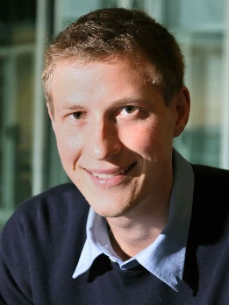

Nearly Tight Sample Complexity for Matroid Online Contention
Moran Feldman
University of Haifa
(Currently, long term visitor at Queen Mary University of London)
Joint work with:
Ola Svensson
EPFL
Rico Zenklusen
ETH Zurich

Slide 2

Prophet Inequality
X₁
X₂
X₃
X₄
v₁
v₂
v₃
v₄
The input consist of n independent random variables.
Each random variable X_{i} has a known distribution D_{i}.
The realization values are revealed one by one.

Slide 3
Prophet Inequality
X₁
X₂
X₃
X₄
✓
✓
v₁
v₂
v₃
v₄
✗
✗
The algorithm is allowed to pick only one value.
After seeing each value, the algorithm must either:
  Pick the value or terminate,
  or irrevocably give up on that value.

Slide 4
Prophet Inequality
X₁
X₂
X₃
X₄
✓
✓
v₁
v₂
v₃
v₄
✗
✗
The algorithm competes with the value max{v₁, v₂, …} that a prophet would have picked.
The best algorithm is ½-competitive [Krengel and Sucheston (1978)]

Slide 5
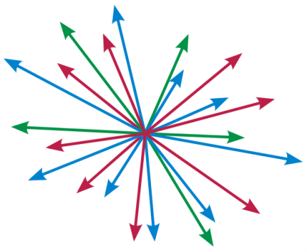
Matroid Prophet Inequality
The algorithm can pick multiple values — subject to a matroid constraint.
Matroid constraints are a rich family of combinatorial constraints.
Everything we say applies also to general matroids.
For simplicity, we think on this case in the rest of the talk.
vector linear independence
limited no. of elements of each type
vector linear independence
cycle free edges in graph
routing traffic to multiple terminals in a directed graph
right vertices of a bipartite graph admitting a matching

Slide 6
Matroid Prophet Inequality (cont.)
X₁
u₁
X₂
u₂
X₃
u₃
X₄
u₄
v₁
v₂
v₃
v₄
Every random variable X_{i} has a vector u_{i}.
In other words, upon revelation of a value v_{i}, the algorithm can select it only if u_{i} is not spanned by the vectors of previously selected values.
The algorithm can select a set of values (e.g., {v₁, v₂, v₄}) only if the corresponding vectors ({u₁, u₂, u₄}) are linearly independent.

Slide 7

Samples
To be more accurate, the guarantee is
O(log k log log² k + log n) ,
where k < n is the maximum size of a feasible set.
The optimal algorithm for the Matroid Prophet Inequality is 2-competitive. [Kleinberg and Weinberg (2012)]
Let’s get behind the scene…
Fu, Lu, Gavin Tang, Wu, Wu, and Zhang (2024) asked the following question:
“What happens if the distributions are unknown, but we can sample from them?”
They Obtained
4-competitive algorithm
using O(log⁴ n) samples
Our Result
4-competitive algorithm
using O(log n log log² n) samples

Slide 8


Online Contention Resolution Schemes (OCRSs)
Important tool implying results for many stochastic optimization problems. Suggested by us in a 2016 work.
Similar to prophet inequality, but:
  No values for random variables.
  Each random variable X_{i} (called element in this context) is independently active with probability p_{i}.
  An element can be selected only when it is active.
  The p_{i}`s form a feasible fractional solution.
v

Slide 9

Online Contention Resolution Schemes (OCRSs)
Important tool implying results for many stochastic optimization problems. Suggested by us in a 2016 work.
Similar to prophet inequality, but:
  The goal is to select each element with good probability conditioned on it being active.
  Formally, we say that the OCRS is c-selectable if
  and we want c to be large.
v
$$\operatorname{Pr}\left[X_{i} is selected \right|X_{i} is active] ≥c ,$$

Slide 10

Results for Matroid OCRSs
[Feldman et al. 2016]
4-competitive Matroid Property Inequality (known distributions)
The prob. p_{i} are known:
Implies
4-selectable
Fu et al. also proved a lower bound of Ω(log k) samples for any constant selectable OCRS.
[Fu et al. 2024]
Works against a more powerful adversary compared to the 2-competitive algorithm.
The prob. p_{i} are unknown:
4-competitive Matroid Property Inequality using
O(log⁴ n) samples
4-selectable
using
O(log⁴ n) samples
Implies
O(log k log log² k)
O(log k log log² k + log n)
(our result)

Slide 11


Matroid OCRS for Known p_{i}
Let R be a set containing each active element with probability ½.
The OCRS finds a subspace A such that:
  The rank of W is smaller than the full rank by a constant factor c > 1.
  For every element e outside A,
  $\operatorname{Pr}\left[e is spanned by A∪R\backslash \{e\}\right]≤1/2$ .
Feldman et al. proved that such a subspace exists.
A
e

Slide 12
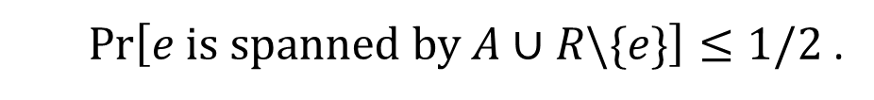
Matroid OCRS for Known p_{i} (cont.)
The OCRS selects every active e ∉ A with probability ½ if is not spanned by W and previously accepted elements.
The set of accepted elements is dominated by R, so each active e ∉ A is accepted with probability (1/2) ∙ (1/2) = 1/4.
The OCRS recurs within A. Depth of the recursion O(log k).
  $\operatorname{Pr}\left[e is spanned by A∪R\backslash \{e\}\right]≤1/2$ .
A
e

Slide 13


Matroid OCRS via Samples
The construction of A is done by calculating probabilities of various events.
The natural approach given sample access, is to try to estimate these probabilities.
So, what is the problem?
Our total budget is O(log k log log² k) samples.
We need to construct O(log k) sets A.
The budget for every set A is only O(log log² k).
With such a low budget, many probability estimates are going to be very wrong.

Slide 14

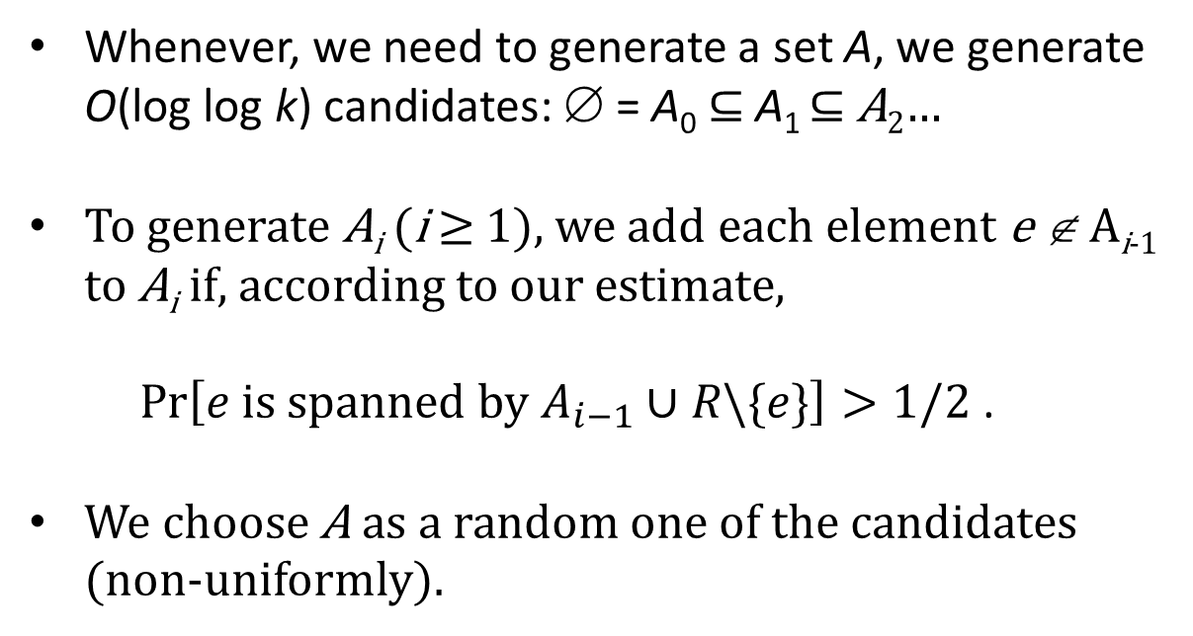
Solution
Whenever, we need to generate a set A, we generate O(log log k) candidates: ∅ = A₀ ⊆ A₁ ⊆ A₂…
To generate A_{i} (i ≥ 1), we add each element e ∉ A_{i-1} to A_{i} if, according to our estimate,
  $$\operatorname{Pr}\left[e is spanned by A_{i−1}∪R\backslash \{e\}\right]>1/2\text{ .}$$
We choose A as a random one of the candidates (non-uniformly).
A
A₁
A₂
A₃
e

Slide 15

Why Does It Work?
For the OCRS to work on an element e, it is only necessary for the estimates of e itself to be correct.
Assume e ∈ A_{i} \ A_{i-1} and A = A_{j}
j<i-1
j = i -1
j ≥ i
We have Pr[e is spanned by A ∪ R \ {e}] ≤ ½ .
Bad case, but with bounded probability.
Decision about e is deferred to the recursion
Beyond this idea, the main technical challenge in the paper is showing that the rank of A is not too large, despite the many wrong estimates.

Slide 16
Questions
?
?
?
?
?

